Slide 1
Enabling Impact through Policy: Cares for Impactful Research
Professor Joshua Ka Ho MOK
Vice-President, Lingnan University

Slide 2
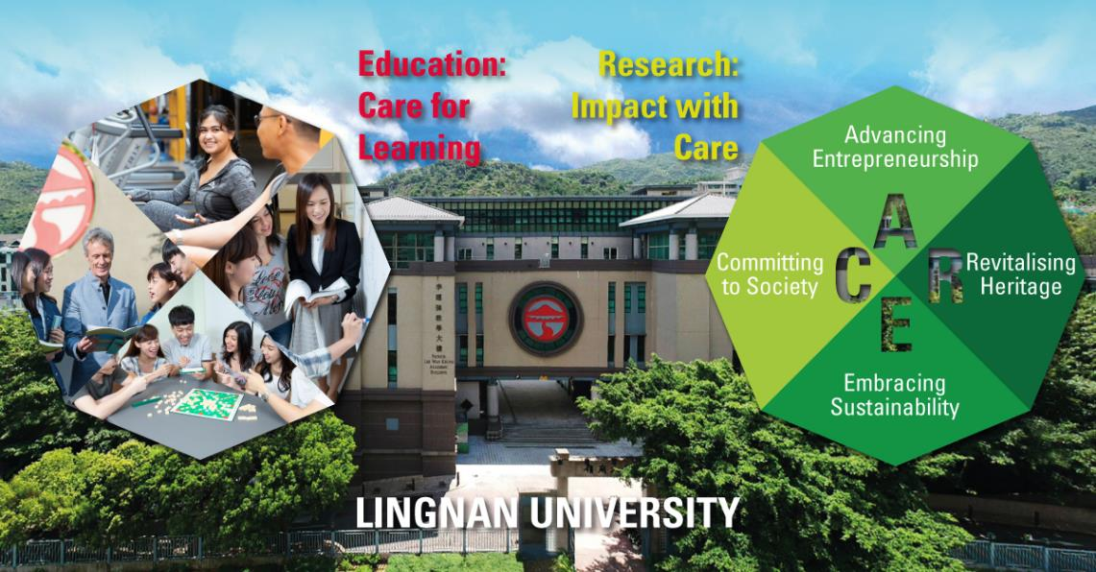

Slide 4
Liberal Arts Education: Transformation For Life
Synergizing Research and Teaching & Learning;
Fostering an ethical work environment with clear values, priorities and standards in promoting UN SDGs;
Exemplifying Research with Social Impact;
Elevating Research Caring for Human Well-being and Humanitarian and Inclusive Entrepreneurship
Turning Crisis into New Research Opportunity

Slide 5
Government Research Policy
Research Assessment Exercise
International Reputable Outputs
Research Impact Cases
Broader Conception of Knowledge Transfer
Wider Engagements
Social and Economic Impacts
Research beyond the Academia, promoting deep collaboration with the Government, Business, Community and Wider Society

Slide 6
COVID-19 Pandemic Crisis and Research Leadership
Leadership is needed when people feel hopeless
Caring leadership is crucial for lifting people up
Decisive leadership with faith can turn crisis into new opportunity
Leading people to focus NOT on problems / challenges alone but Opportunities for Development from comparative / spiritual perspectives
Engaging people to work towards strategic goals during crises
Working as team for turning crisis into new opportunities
Bringing Faith, Hope and Love to people who are facing difficult times

Slide 7
As the world faces a global pandemic, Lingnan University has launched the Fighting COVID-19 @ Lingnan campaign during 2020, which comprises a series of projects and initiatives to care for the local and community and beyond
In this difficult time when social distancing is required to save lives, the need for caring is ever more needed to alleviate hardship. This is what we demonstrate in our research and KT work

Slide 8
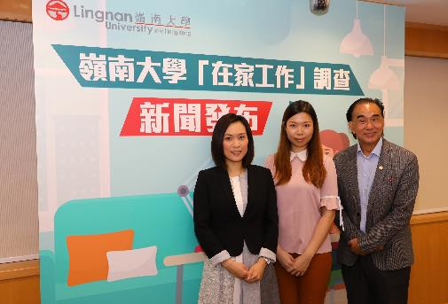
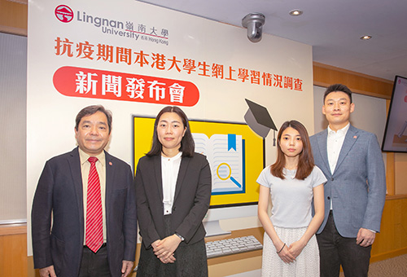
Some research projects for Fighting COVID-19 @ Lingnan
Working from Home under COVID-19
Online learning experience of university students under COVID-19

Slide 9
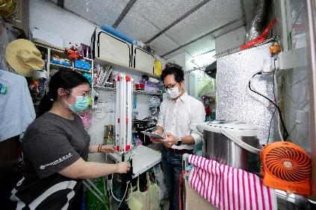
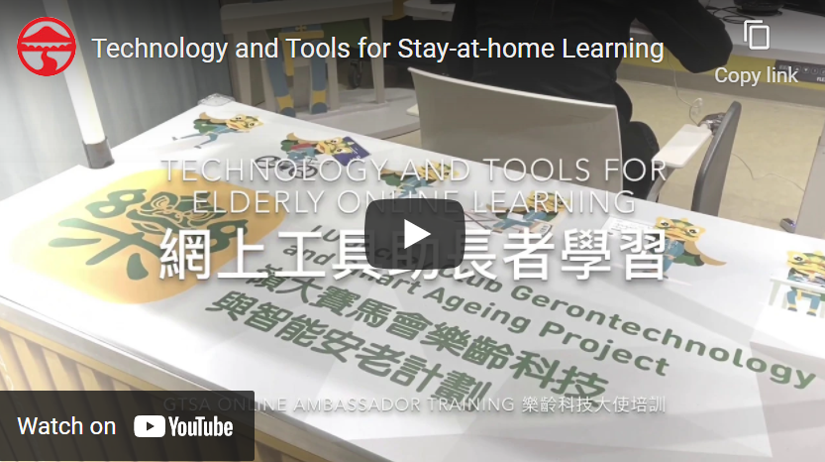
Some research projects for Fighting COVID-19 @ Lingnan
Project Ultra Violite: Rapid Disinfection
Service for Sub-divided Units
Technology and Tools for Stay-at-home Learning

Slide 10
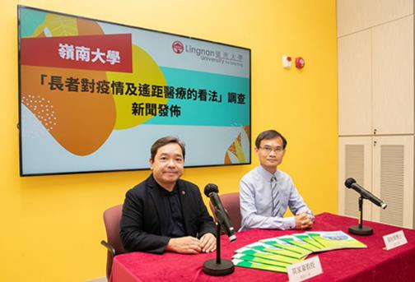
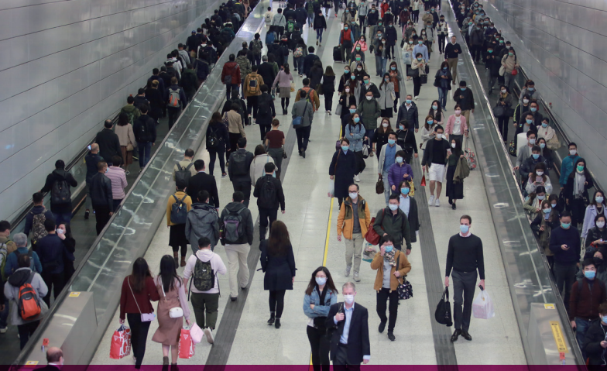
Some research projects for Fighting COVID-19 @ Lingnan
Perceptions on the COVID-19 epidemic of
the elderly in HK
Advice on Anti-COVID-19 Measures (mental well-being)

Slide 11
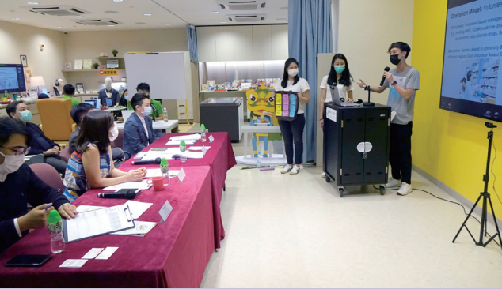
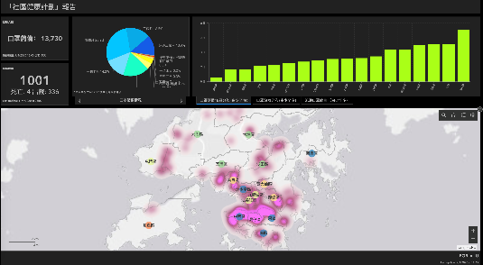
Some research projects for Fighting COVID-19 @ Lingnan
Fighting COVID-19: Technology, Humanity and Society Series
Using GIS to implement Social Responsibility during the COVID-19 pandemic

Slide 13
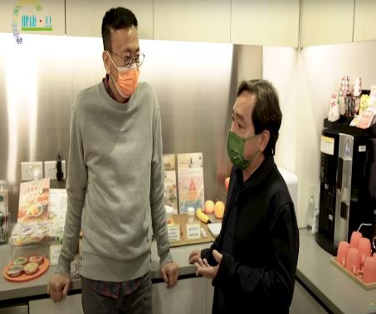
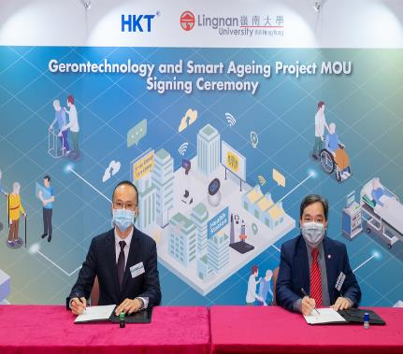

Slide 14
Gerontechnology and Productive Ageing
https://youtu.be/h_uKdg9DqXQ
Ageing population is increasing in Hong Kong and asia
Reaching out to the Community, assessing people’s needs
Base line research informing appropriate interventions
Programme evaluations for policy advocacy and practice enhancement
Supporting the Government policy “ Ageing in Place” and Community Integrated Care

Slide 15
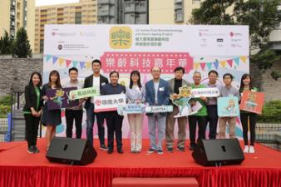
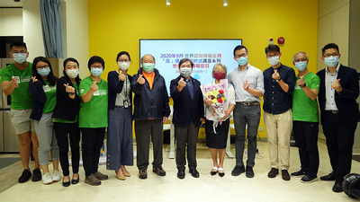
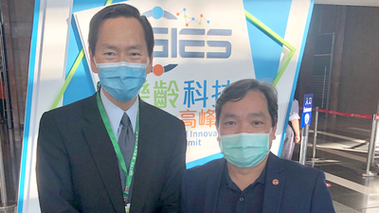
Gerontechnology & Productive Ageing @ LU

Slide 17
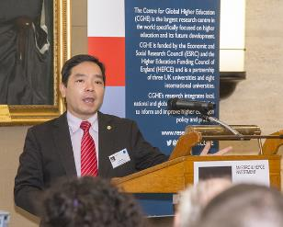
Centre for Global Higher Education (CGHE)
Largest research centre in the world specially focused on higher education and its future development
Launched in an international public seminar held in
February 2016 in London
Lingnan University becomes
a partner of this Center led by
Partners:

Slide 18
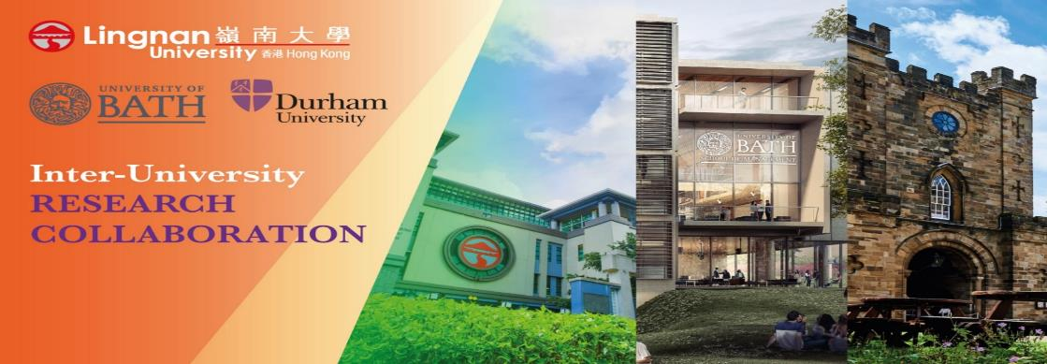
Lingnan University, University of Bath and Durham University developed a strong collaborative partnership
Lingnan is one of the core partners in the new
Centre for Research in Education in East Asia

Slide 19
VISION
Aspiring to become a leading interdisciplinary, multi-disciplinary and inter-university research platform for research into Asia’s economic and social development, policy and governance from comparative and international perspectives.
OBJECTIVES
The Institute promotes:
Research partnerships with leading research centres / consortium that ensure high quality comparative development and policy studies;
Interdisciplinary, multi-disciplinary policy and development research with positive impact on social and economic development, enhancing human betterment and good governance;
Studies of Asian interactions with other major global regions from international and comparative perspectives;
High quality professional training in policy, development and governance studies from international and comparative perspectives.

Slide 20
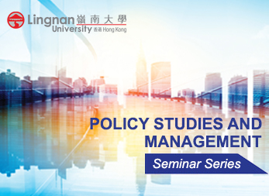

Slide 21
Fighting COVID-19 @ Lingnan
The “Fighting COVID-19 @ Lingnan” campaign was widely reported through international webinars and research findings from its initiatives were published in international journals and/or publicized in international media. Some highlights below.
Impact of COVID-19 Pandemic on International Higher Education and Student Mobility: Student Perspectives from Mainland China and Hong Kong
Promoting effectiveness of “working from home”: findings from Hong Kong working population under COVID-19
Converging humanitarian technology and social work in a public health crisis: a social innovation response to COVID-19 in Hong Kong
The UGC also appreciates the “Fighting COVID-19 @ Lingnan” campaign that was launched to fight against the pandemic together with the community

Slide 22
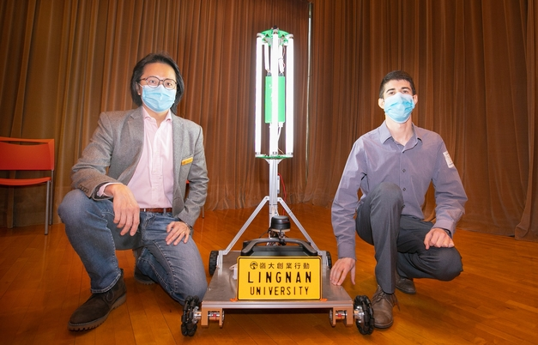
LU develops autonomous UV-C disinfection robot providing effective and efficient sanitisation for large indoor establishments

Slide 23
Health and Wellbeing
https://www.youtube.com/watch?v=otT4FGXbgOQ

Slide 24
Economic Impact: International Trade
Https://www.youtube.com/watch?v=tjdnBmn5Wgc&t=3s

Slide 25
As an institution Caring for Student Learning, the School of Graduate Studies launches the "C C 4 U" Campaign to Closely Connected Different Learning Enhancement Programmes for YOU with 4 C.

Slide 26
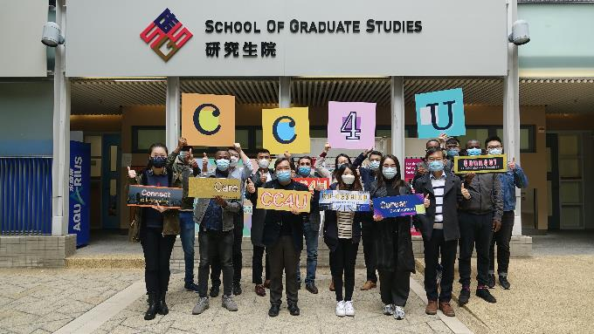
Connecting students to the international research and learning community
Connecting students to conduct research and reach out to the local society and beyond
Connecting students to co-developing a productive research environment and career development
Caring student well-being

Slide 27
LU launches Chinese Medicine Promotion Programme showing the efficacy of Chinese medicine in preventing COVID-19 in the elderly.
LU believes that Chinese medicine practitioners can reduce the risk of infection in older people and contribute to society in general in the spirit of "prevention is better than cure".
LU provides Health Coupons for Students to seek Chinese Medicine & Health Care.

Slide 28
UGC Recognition
UGC appreciates LU’s efforts in launching the “Fighting COVID-19 @ Lingnan” programme, which has effectively met the changing needs of the society, amidst the challenging moment. We wish that the plan for next phase of the programme would achieve great success and contribute to the community-wide efforts in fighting the coronavirus.
Our Reflections:
Learning to serve
Serving for Impact with Care
Turning crisis into opportunity
Be humble, Led by example
Being transformed first and to transform others through promoting collegial work culture
Bringing “Faith, Hope and Love” to the Society
Caring is DNA of Servant and Transformative Leadership

Slide 29
Thank you

